Slide 1
Time Series Analysis and Sales Forecasting for Automotive using IBM Services
Presented By
Hitesh Agrawal - 19BAI10030
Shiv Taneja - 19BAI10039
Krishan Kumar Gupta - 19BAI10114
Shrutika Nikhar - 19BCY10107

Slide 2
Project Introduction
In this project, we are building a system that analyses the previous trends of sales of an automotive, finds hidden patterns, detects trends in sales over the years, and predicts sales in the future.
The objective of the project is to build a web application where the user gets a prediction on price of automobiles based on the provided date.
For that we will be using Fbprophet, IBM cloud and Flask like services.

Slide 3
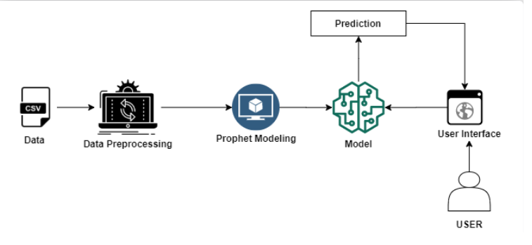
Project - Flow:

Slide 4
Pro/Cons
Our solution for the Time Series Analysis and Sales Forecasting for Automotive have following advantages and disadvantages.
Advantages:
Time series analysis helps in identifying the patterns and also creates the opportunity to clean your data. It gives the high accuracy and provides simplicity in executing.
It is a really handy tool for forecasting purposes. It gives accurate predictions for future values, but it also requires more skill than regression analysis since you need to adapt your model according to the historical data.
Disadvantages:
Time series analysis is useful for short-term forecasting, but it could sometimes lead to wrong predictions. This is because it requires historical data in order to construct the models, which means that if some significant changes occurred over time, then those changes will not be included within the forecasted periods.
Our model has been built on historical data, so it cannot be used to predict future values or trends that are too far.

Slide 5

Application
By using our solution for the Time Series Analysis and Sales Forecasting for Automotive we can do the following things:
1. A potential buyer of a used car will get a range of car resale value. So that one can buy the used car according to the range.
2. Manufacturing companies will get a basic resale value range so that they can set the pricing of upcoming cars in such a way that the resale value remains high than the previous year's data of existing cars.

Slide 6
Conclusion
Future Scope
The overall purpose of the study was to prove that it’s possible to efficiently forecast car sales using a simple statistical model. During our research we were able to prove that the Decision Tree Regressor based approach has acceptable outcomes. Such models can be easily implemented with various statistical software and their computational complexity is acceptable. Also, the approach has well-studied statistical properties.
The accuracy of the predictive model for car sales forecast obtained is 87.9%. Hence it has been proved that the percentage error is not greater than 12.1 % for each of the 12 months ahead. Obviously, the accuracy of the model is high enough and the model can be used as a baseline for developing better models. The method is well suited for use in different business domains.
Our only concern about the project is that It can only extract linear relationships within the time series data. Predictions generated may not be suitable for complex nonlinear cases. It does not efficiently extract the full relationship hidden in the data. Another limitation is that the model requires a large amount of data to generate accurate predictions. Hence these above are the two current issues that could be addressed for prospects.

Slide 7
References
Importance of Time-series [Business Sector] - http://home.ubalt.edu/ntsbarsh/stat-data/forecast.htm
Insight into Time-series Analysis - http://www.jetir.org/papers/JETIR2107494.pdf
Existing Works - https://www.researchgate.net/publication/353659148_Analysis_of_Time_Series_Forecasting_Techniques_for_Indian_Automotive_Industry
Practical Implementation and Insights - https://mindcraft.ai/concepts/time-series-analysis-and-sales-forecasting-for-automotive/

Slide 8
Thanks

